Slide 1
Shortcut-JFS: A Write Efficient Journaling File System for Phase Change Memory
Eunji Lee, Seunghoon Yoo, Jee-Eun Jang
^{Dept. of Computer Engineering}
^{Seoul National University}
^{Seoul, Korea}
^{Hyokyung Bahn}
^{Dept. of Computer Engineering}
^{Ewha University}
^{Seoul, Korea}
2012 IEEE 28th Symposium on Mass Storage Systems and Technologies (MSST)

Slide 2
Introduction
Backgrounds
Reliability
The most important issue to be taken into account in the design of modern file systems.
Mobile devices - smartphones and tablets
Sudden power failures occur more frequently
Need recovery after a system crash
Modern Reliability File System
ext3 and ReiserFS
Emerging PCM (Phase Change Memory)
One of the reliability techniques : Journaling

Slide 3
Introduction
Journaling
Journaling for PCM
PCM : A high-speed nonvolatile storage media
Physical characteristics
Very different from those of HDD or Flash
How Journaling Works (자세히)
A write request arrives → Write data in journal area (Write-ahead logging) → Checkpointing
Checkpointing : Apply new data to the original data location periodically
Always maintain consistent data!
in the journal area or in the original location

Slide 4
Introduction
Characteristics of Journaling in Hard Disks
Overhead in HDD
More writes, but it is efficient
It reduces large seek overhead by writing sequentially to the journal area [Sequential Pattern]
Overhead in PCM
PCM has no seek time but long write latency
Without achieving any advantages from sequential logging
(자세히)
Serious Performance Degradation
Need to provide an efficient handling of write operation

Slide 5
Introduction
Shortcut-JFS
Shortcut-JFS
reduces write amounts (by more than a half of existing journaling file systems)
while providing high reliability

Slide 6
RELated works

Slide 7
Exploiting PCM
Mogul elt al.
Efficient Memory Management Policy
Hybrid Memory System Consisting of both DRAM and PCM
Page-attribute aware memory allocation policy
Placing read-only pages (like code segments)
Memory Architecture
It uses a small amount of DRAM as a write buffer of PCM
To prolong the lifetime and hide the long write latency of PCM

Slide 8
Exploiting PCM
Lee et al.
PCM Memory Architecture
To improve the write performance between last level cache and PCM memory
Two Policies
Buffer Reorganization
Partial Writes
These track data modification and write only modified cache lines or workds to the PCM array
CLOCK-DWF Algorithm
For hybrid memory architecture (DRAM + PCM)
PCM : Read-intensive Pages
DRAM : Write-intensive Pages
Reference Other's Works!

Slide 9
Exploiting PCM
Zhou et al.
Two wear-leveling techniques for PCM memory
Row Shifting
Segment Swapping
To prolong the lifetime of PCM
Ipek et al.
Dynamically Replicated Memory
It maps two faulty physical pages into a single logical page
Thereby Reusing PCM pages that contain hard faults

Slide 10
For Non-Volatile RAM
Past Studies
Non-Volatile Memory
Total capacity is too small
Thus, only limited part of file system image is located on the NVRAM
PRAMFS
Stores frequently accessed or important data in NVRAM
MRAMFS and NEB-FS
To improve the space efficiency of NVRAM
MRAMFS : Compressing Metadata
NEB-FS : Compressing Metadata by extent-based file management

Slide 11
For Non-Volatile RAM
Recent Studies
Non-Volatile Memory
Improves Rapidly!!
Recent Studies : Keeping entire file system image on NVRAM
Baek et al.
Software layer implementation
Unified Memory File System : PCM = Main Memory & Storage
To support both file objects and memory objects together

Slide 12
For Non-Volatile RAM
Recent Studies
Condit et al.
BPFS for byte-addressable storage
In-place write
when the updated data size is smaller than atomic operation unit.
Reduce the outplace-update overhead of copy-on-write
Wu et al.
For storage class memory
Storage Class Memory resides on the memory bus
It can be accessed directly from CPU
File system accesses the same address space of VM Systems

Slide 13
Summary for Related Works
Could not find researches on the journaling file system for PCM
(They insist) Shortcut-JFS is first journaling file system that uses PCM

Slide 14
Shortcut-journaling file system

Slide 15
Shortcut-Journaling File System
Introduction
Reduce Write Amounts
by more than a half of existing journaling file systems
Two Schemes
Differential Logging (Logging Step)
Write only for changed bytes in the journal area
This is possible because a write operation of PCM can be performed by the unit of a cell
In-place Checkpointing (Reflect to the original location)
Do not copy the log to the original location, when applying the logged data
Just by modifying a pointer to indicate it
Why doesn't do this in case of HDD?
Physical location of journal area will be scattered as time goes on
This Increase the seek time!

Slide 16
Shortcut-Journaling File System
In-place checkpointing (Continuous)
Cannot be used when logged data is smaller than a block
Because the logged data itself should be changed into the data block of file systems to perform in-place checkpointing
When an updated data size is larger than a half of a block
Use Block Logging (Logs an entire block) instead of using differential logging

Slide 17
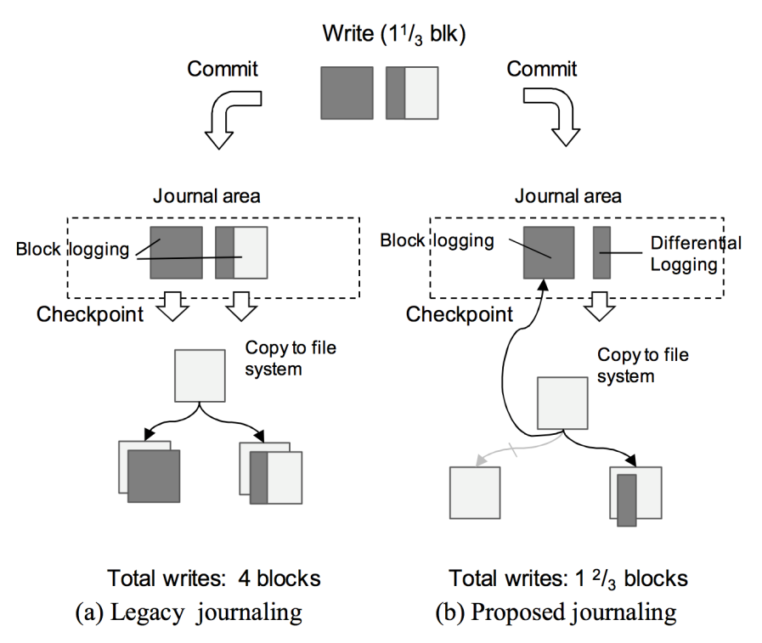
Journaling Algorithm
Comparison (In case of writing 1+1/3 blocks)
Legacy journaling scheme
Total 4 blocks (2 blocks for logging and 2 blocks for checkpointing)
Shortcut-JFS
Total 1+2/3 blocks (1 + 1/3 blocks for logging and 1/3 block for check pointing)

Slide 18
How it works?
Assumptions
Block Size : 1KB
inode Size : 256B
Scenario
Write Request Size 800B spanning two different blocks
A set of low-level writes
Two data block updates
One inode updates (for metadaa update)
Shortcut-JFS handles a series of low-level write operations atomically and guarantees the file system consistency as follows

Slide 19
How it works?
Begin Transactional Writes
by creating a new transactional handler
To provide atomicity
Transaction status : PENDING / COMMIT / CHECKPOINT
Transaction Status : PENDING
Writes the updated data into JOURNAL
Decides mode between differential logging and block logging (by size)

Slide 20
How it works?
Turning to scenario
First Block is 600B, it is larger than a half of a block. Thus do block logging!
Second Block is smaller than a half of a block Thus do differential logging!
Third Block is inode update
In case of inode, it logs by the unit of an object
As a result, three log chucks are logged in JOURNAL
Every chunk has its header
Headers are linked in the transaction list

Slide 21
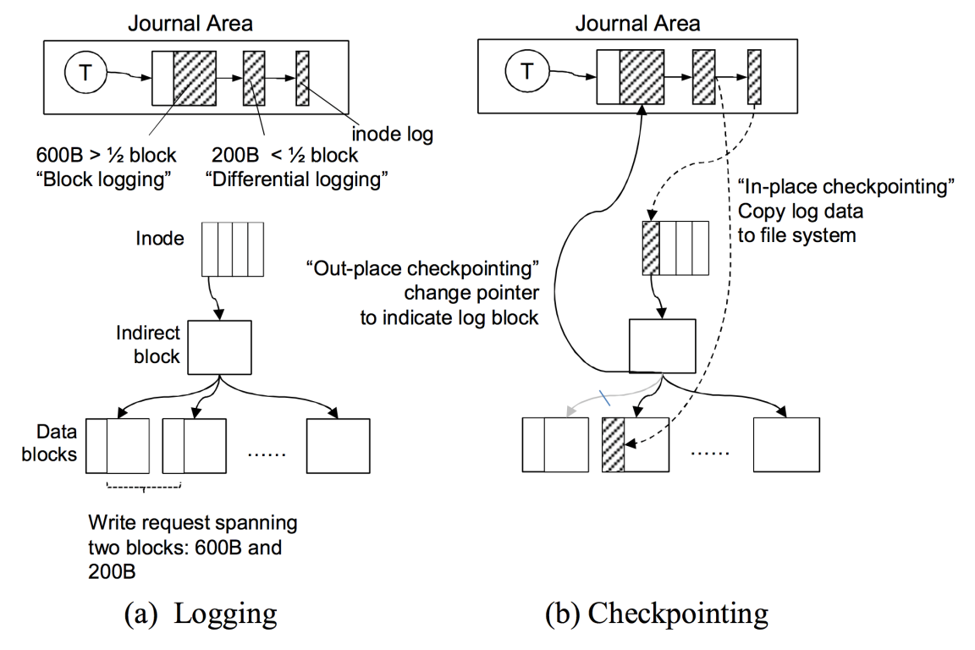
How it works?
After all updates for one transaction logged successfully
Transaction Status is changed into COMMIT
Committed transactions are guaranteed to remain durable

Slide 22
How it works?
Now, Reflect it to the FS
Checkpointing: Logged data → File System
Checkpointing
Performed periodically
Activated when no more space in JOURNAL area

Slide 23
How it works?
Checkpointing Progress
Scan all transactions committed after the last checkpoint
Flush their logged data to each location in the FS
In-place checkpointing and Out-place checkpointing are performed at this point!
Rewrite operation is happened only on Out-place checkpointing
All logged chunks are checkpointed, transaction status is changed into CHECKPOINT
CHECKPOINT Status
Journal area occupied by this transaction

Slide 24
How it works?
Comparing Total Amount
Shortcut-JFS
1.2KB = 600B + 200B + 200B + 200B
Legacy FS (ext3)
4KB = 1 KB + 1KB + 1KB + 1KB

Slide 26
System Recovery
System Failure Scenario
A system crash can occur during logging
The file system remains as the last checkpoint state
Redo operation from the last checkpoint position
Discard partially written transactions with PENDING status to prevent corrupted data
A system crash during checkpointing
Transaction is partially reflected to the FS
However, this transaction is still remains perfectly in journal area!
Just restore it!

Slide 27
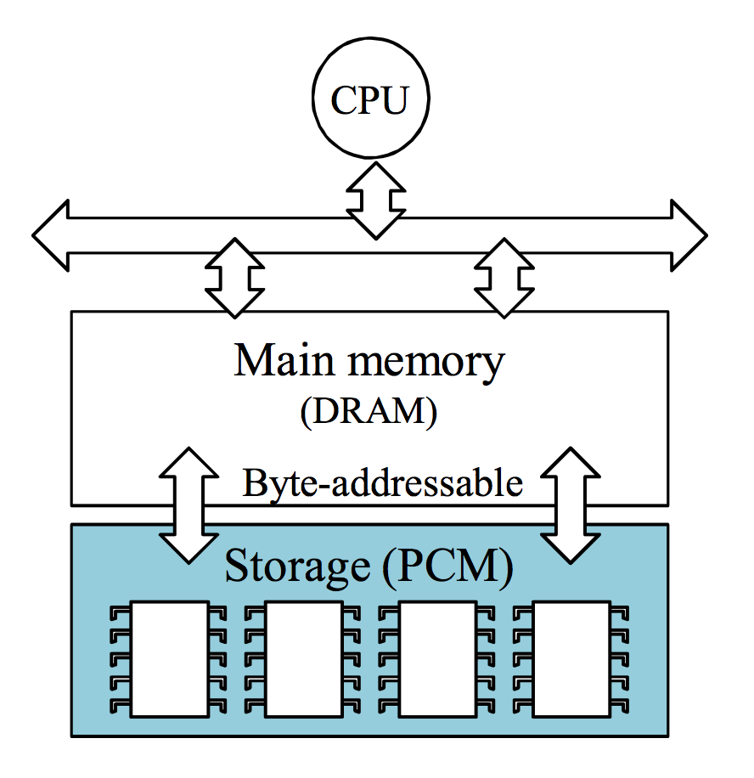
System Architecture
System Architecture
Supporting Byte Access Interface
Between main memory and storage device (PCM)
Assume PCM to be placed in DIMM slot
Weakness: limited capacity by the number of slot
A new interface?

Slide 28
Performance evaluation

Slide 29
Performance Evaluation
Experimental Environment
HW/SW
Linux Kernel 2.6.32.24
Implemented by integrating journaling algorithms into ramfs
Use DRAM like PCM
To compare
ext3 mounted on ram-disk
Measuring Performance
iozone: micro benchmark to measure file I/O performance
postmark: macro benchmarks (emulates an email server or web apps)

Slide 30
Performance Evaluation
Exprement #1
Use iozone / postmark
Just performance test
Configuration
Block Size: 4KB
Commit Policy : in every 5 seconds, but unknown size (default: 128MB)
Postmark fileset config
Fileset1: 1000 Transactions on 1000 files of 1MB size
Fileset2: 10 Transactions on 10 files of 50MB size
To investigate the effectiveness under different write sizes
Varying the write size from 1KB to 4KB

Slide 31
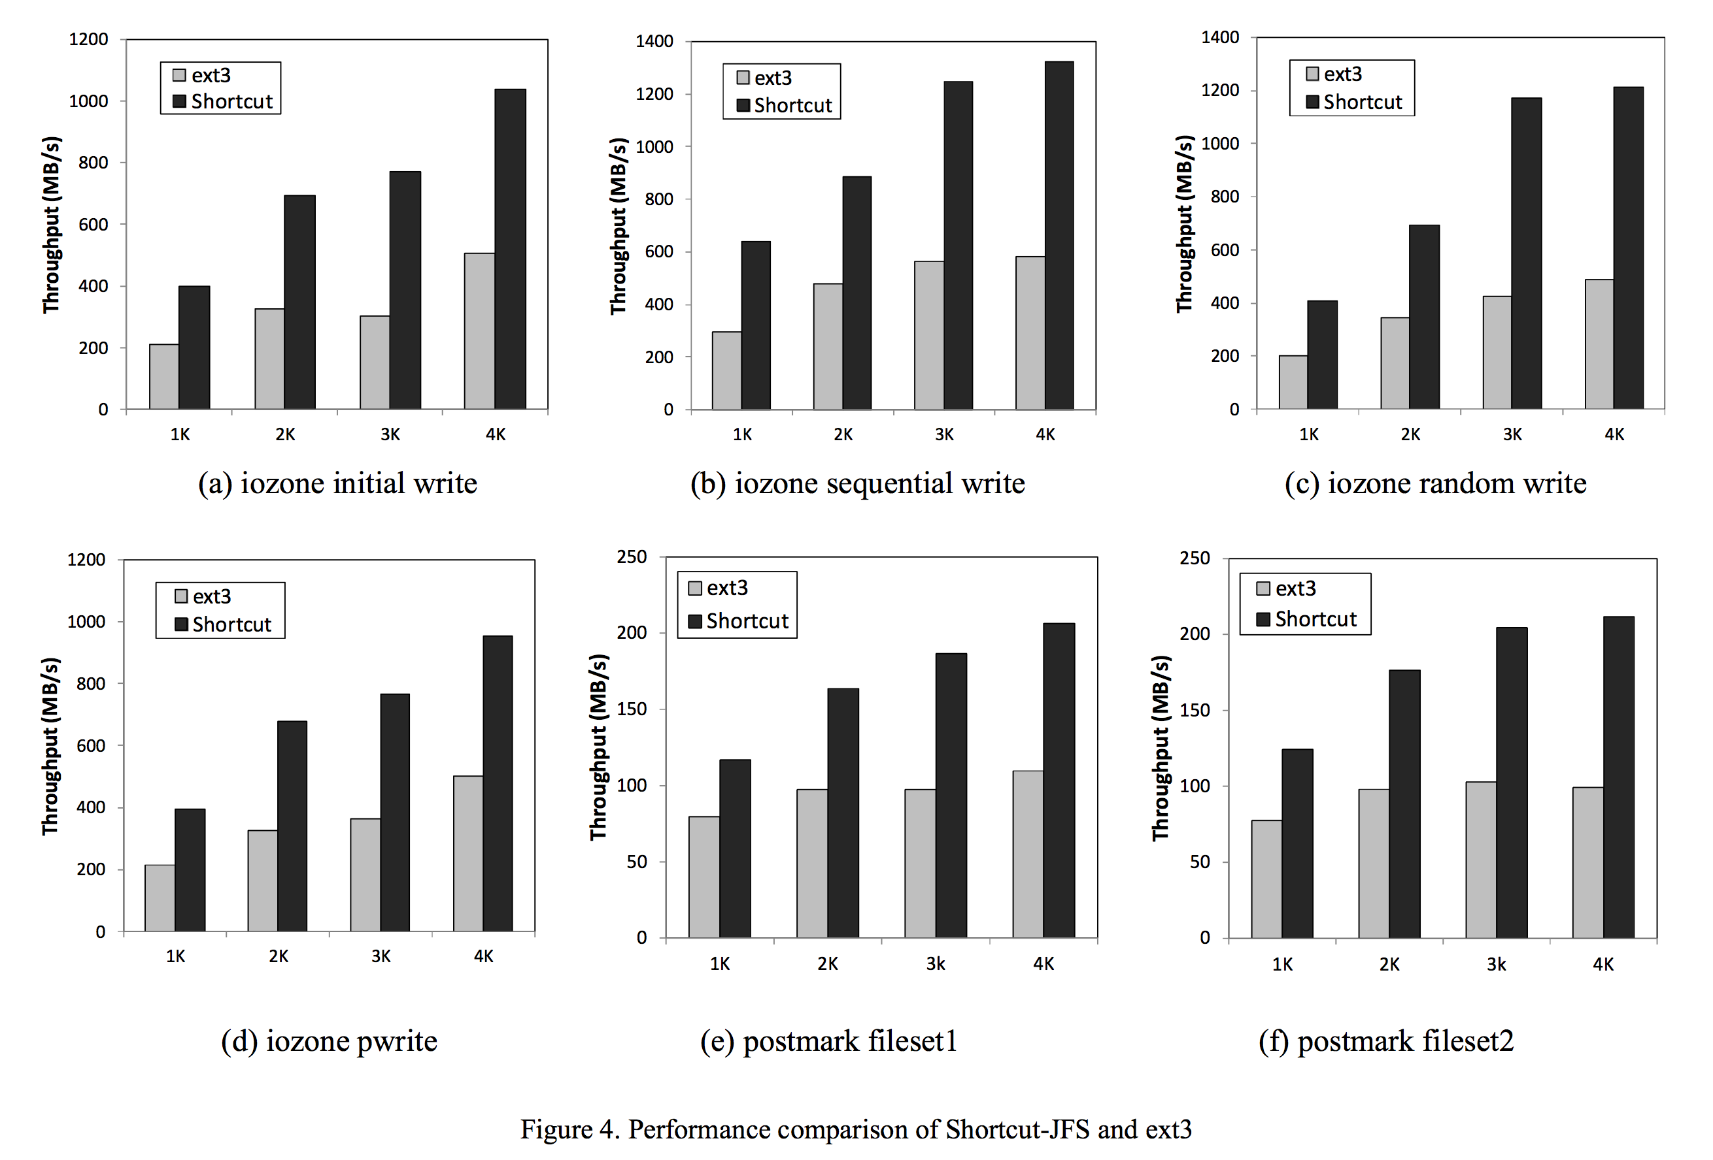
Experiment #1 Results
Performance comparison of Shortcut-JFS and ext3
2.1x Improvement
1.8x Improvement

Slide 32
Experiment #1 Analysis
Exprement #1
Shortcut-JFS improves I/O performance
By 2.1x on average for iozone
By 1.8x on average for postmark
For all ranges of write sizes, Shortcut-JFS outperforms ext3
Why the performance improvement is larger in iozone than postmark
Ans: postmark opens and closes a file for every single write operation

Slide 33
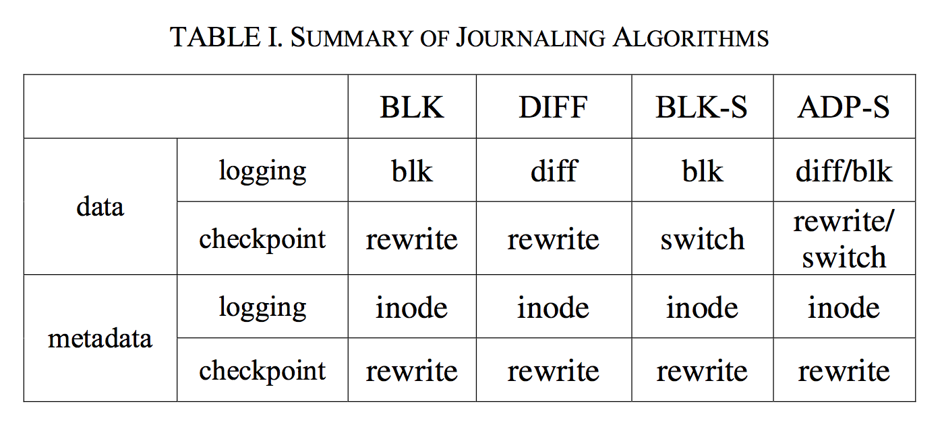
Performance Evaluation
Exprement #2
To investigate the effectiveness precisely
Implementation : Four versions of jounrnaling file systems
Block Logging (BLK) : identical to that of ext 3 and ReiserFS
Differential Logging (DIFF)
Block Logging with in-place checkpointing (BLK-S)
Adaptive Logging with in-place checkpointing (ADP-S)

Slide 34
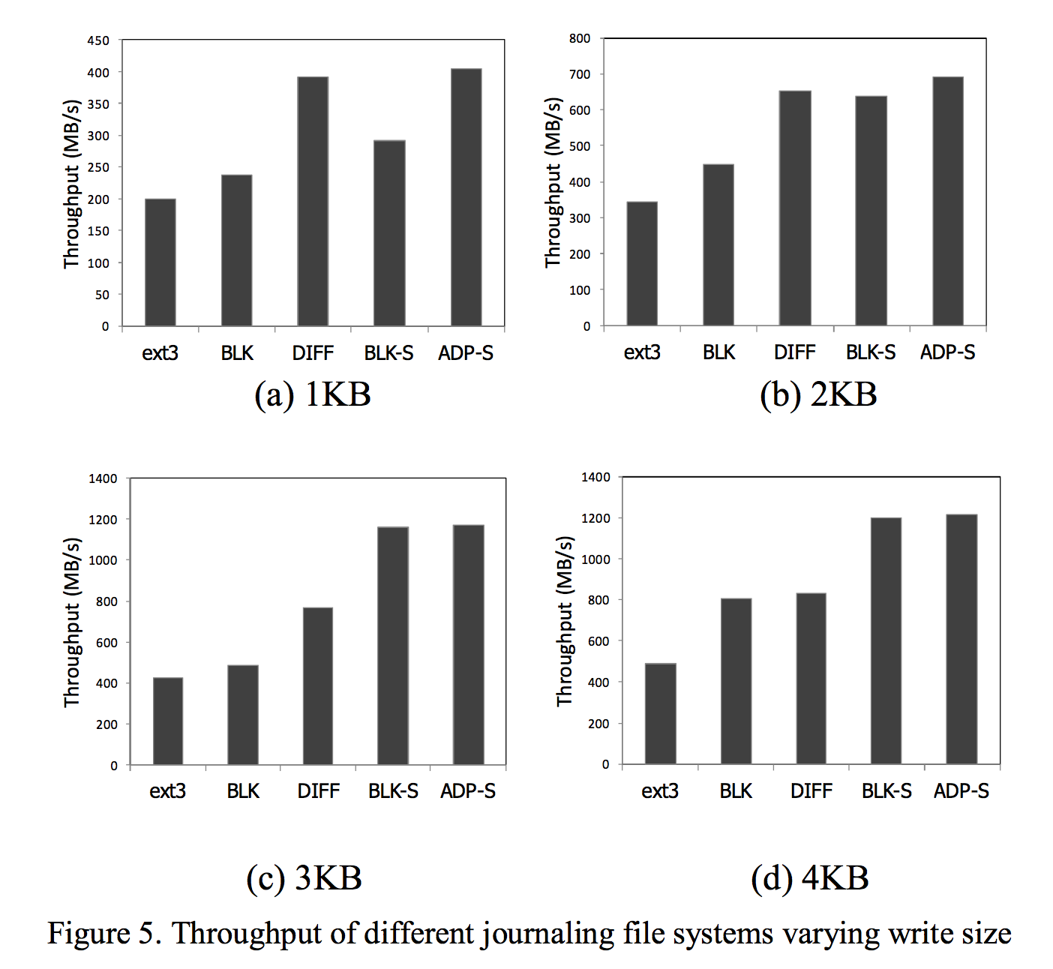
Experiment #2 Results
Throughput of different journaling file systems varying write size
Measuring Performance with different write sizes

Slide 35
Experiment #1 Analysis
Throughput of different journaling file systems varying write size
In case of 1KB write size
DIFF and ADP-S performs well
Because they write differences only instead of and entire block
In case of 2KB write size
ADP-S, BLK-S and DIFF is all good
Three schemes incur same amount of writes

Slide 36
Experiment #1 Analysis
Throughput of different journaling file systems varying write size
In case of 3KB/4KB write size
BLK-S and ADP-S is better than others
Because DIFF should perform write-twice for all updates
ADP-S provides consistently the best
Regardless of write sizes

Slide 37
One Interesting Result
ext3 uses the same journaling scheme as BLK
However, there is a large margin between ext3 and BLK
Because ext should pass through the block-device layer

Slide 38
Conclusion

Slide 39
Conclusion
Shortcut-JFS: New Journaling File System for PCM
Takes advantages of physical characteristics of PCM
Reduces additional writes of legacy journaling
Differential Logging
Logging only changed bytes
In-place Checkpointing
Reusing log blocks as a data blocks
It improves performance by 40% on average to ext3

Slide 40
Future Work
Redesign Their Scheme
Considering wear-leveling
Lifetime issues (PCM has limited write endurance)

